Slide 1
AUTOMATIC BIRTHDAY & ANNIVERSARY WISHES SENDER USING FLASK
Presented by

Slide 2

CONTENT
Introduction
Why we do this?
Modules
Hardware and Software requirements
Diagrams
Output

Slide 3
AUTOMATIC BIRTHDAY & ANNIVERSARY WISHES SENDER USING FLASK
INTRODUCTION

Slide 4
Our Flask-based project aims to revolutionize the way individuals send wishes and greetings by automating the process through email dispatches. At its core, the application offers a user-friendly web interface where users can input necessary details such as sender and recipient email addresses, message content, and the desired date for sending the wish.

Slide 5

Modules
Data Collection.
Email Server Configuration and Dispatch.
User Interaction Webpage.

Slide 6
HARDWARE REQUIREMENTS:
System : AMD PRO A4-430B R4, 5 computer cores 2C+3G 2.50 GHZ
Hard Disk: 256GB
Ram: 4GB
Internet Connection: Yes
Display: LCD 16:9 (1366X768 Pixels HD)

Slide 7
SOFTWARE REQUIREMENTS
Operating system: windows
Front End: HTML, CSS
Back End: Python , Flask
Schedule, VS Code.

Slide 8
EXISTING AND PROPOSED SYSTEM

Slide 9
EXISTING SYSTEM
PROPOSED SYSTEM
Automated Process: The proposed system automates the process of sending wishes, eliminating manual intervention and reducing the risk of errors.
Enhanced Efficiency: Users can schedule wishes in advance, ensuring timely delivery and improving overall efficiency.
Improved User Experience: The intuitive interface and seamless functionalities enhance user experience, leading to higher satisfaction levels.
Manual Process: Sending wishes manually via email involves significant time and effort, leading to delays and oversight.
Limited Automation: Existing systems may lack automation features, making it challenging to schedule and send wishes efficiently.
Risk of Human Error: Reliance on manual processes increases the risk of errors, such as forgetting to send wishes on time

Slide 10
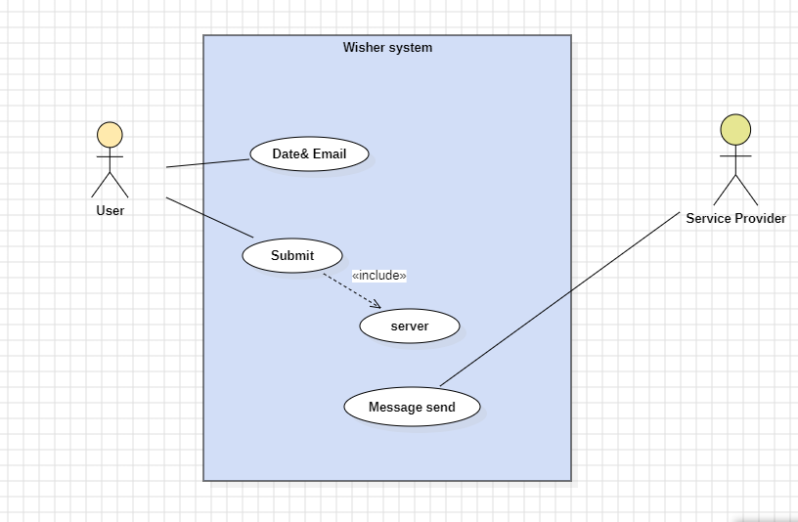
USE CASE DIAGRAM

Slide 11
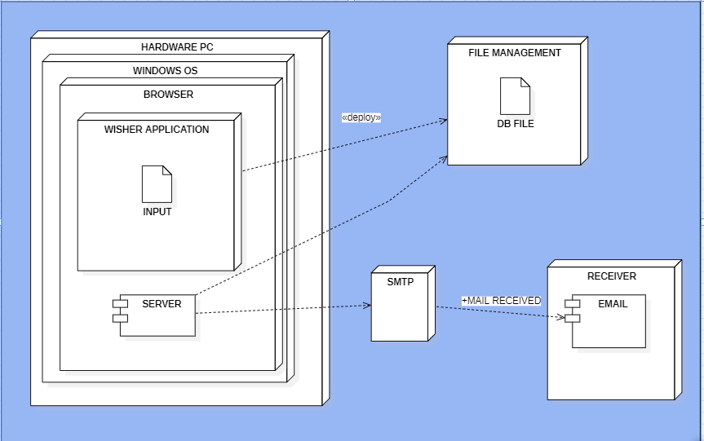
DEPLOYMENT DIAGRAM

Slide 12

OUTPUT
LET’ SEE THE OUTPUT OF OUR PROJECT.
1.WEBSITE OUTPUT
2.SERVER OUTPUT

Slide 13
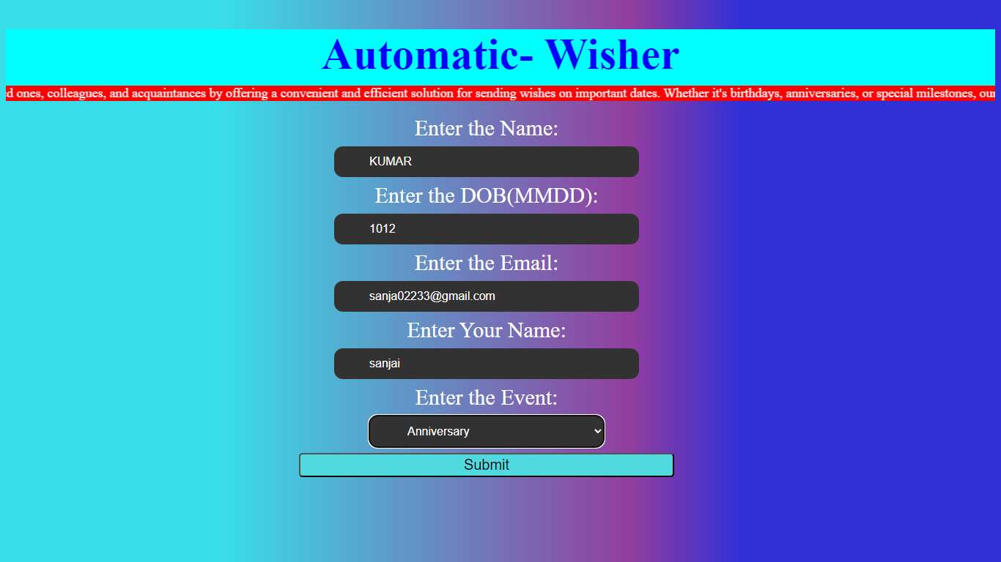

Slide 14
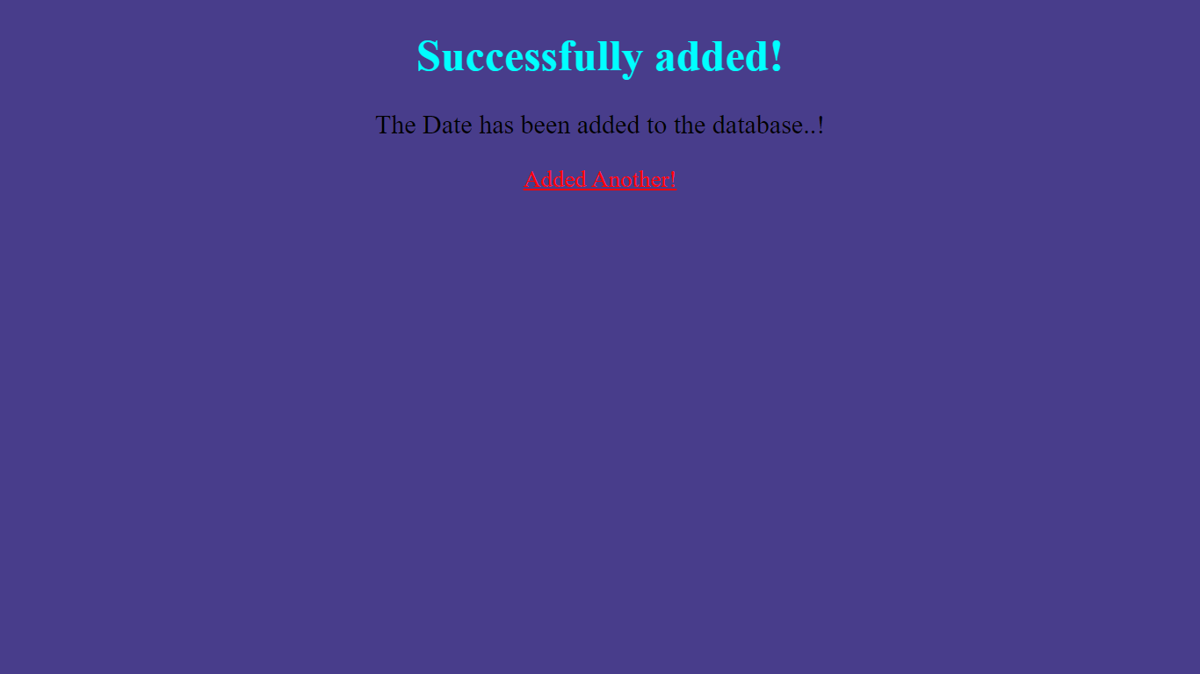

Slide 15
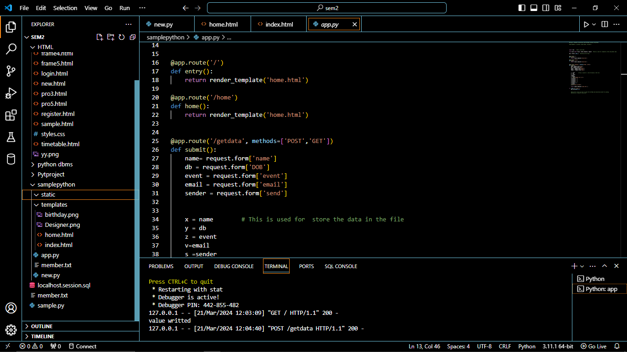

Slide 16
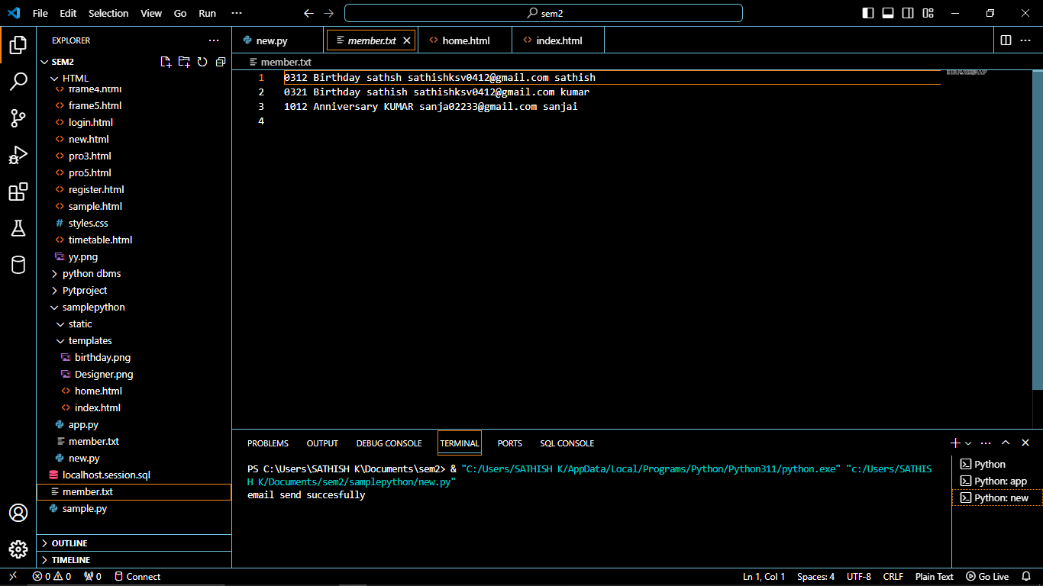

Slide 17
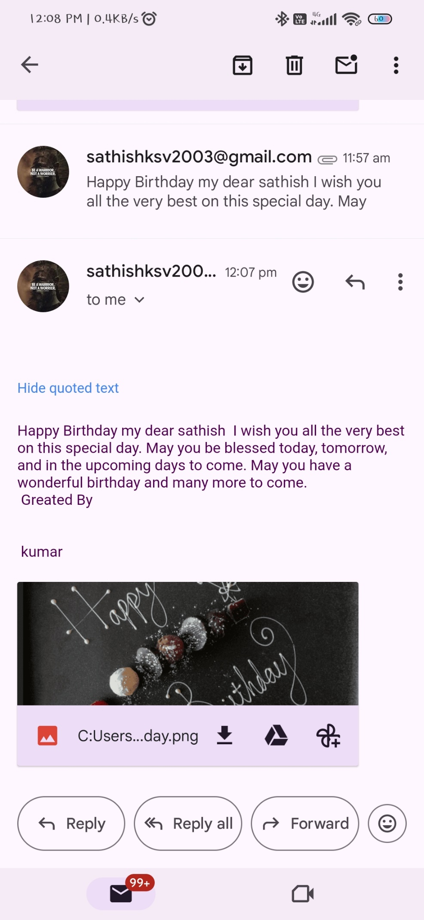

Slide 18
FUTURE ENHANCEMENT
Benefits of the Enhancement
Database Connectivity
Support for Other Events

Slide 19
THANK YOU
ANY QUESTIONS…..?

